Slide 1
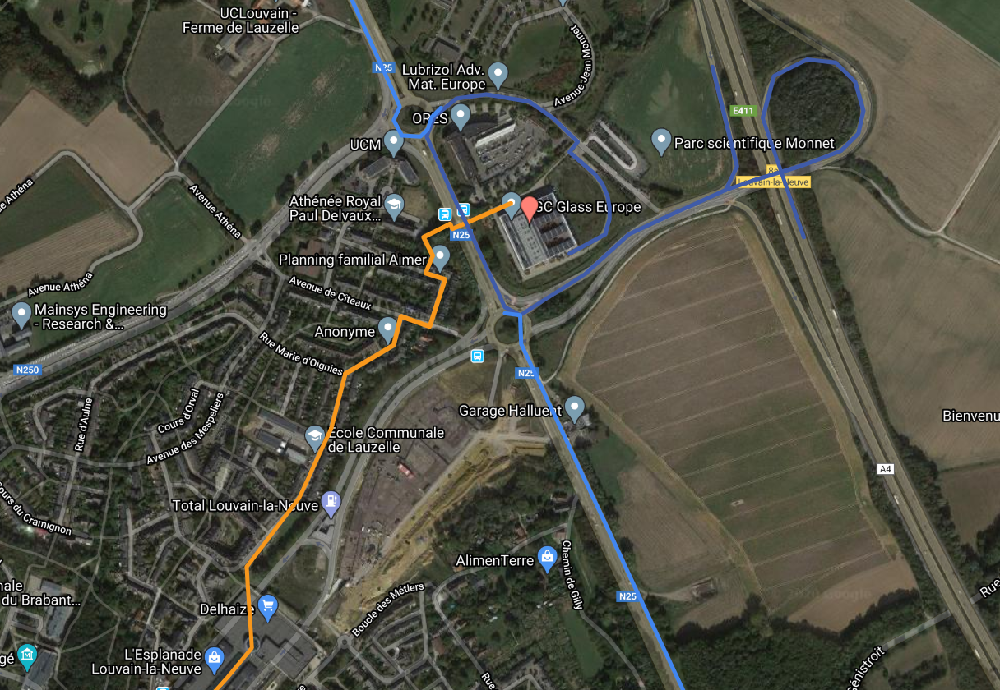
How to reach AGC Glass Europe Headquarters?
Address
Avenue Jean Monnet 4
B-1348 Louvain-la-Neuve
Tel: +32 2 409 30 00
https://www.agc-glass.eu/en
For detailed itinerary, click on this link

Slide 2
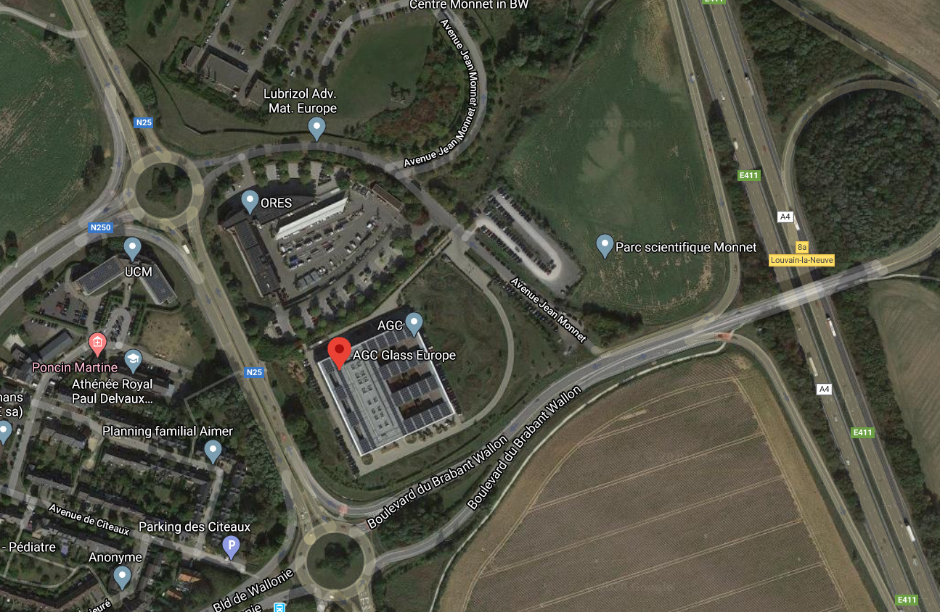
Where to park your car?
Entrance gates
Visitors’ parking
Reception here

